Slide 1
Design Patterns
Behavioural Design Patterns

Slide 2
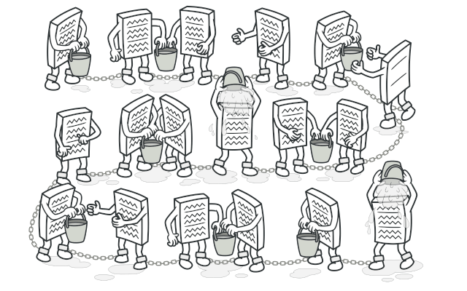
Chain of Responsibility
Transforming particular behaviors into stand-alone objects called handlers.
Each handler performs a function, has a link to the next function in the list and can decide to pass the request on

Slide 3
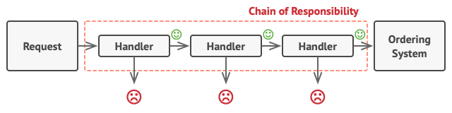
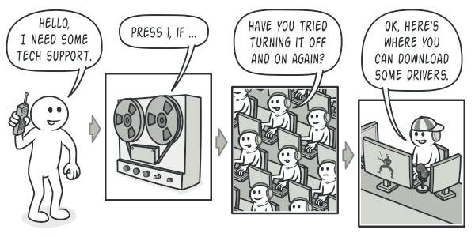
https://www.youtube.com/watch?v=i_dEHmWsZdA
Notes:
Transforming particular behaviors into stand-alone objects called handlers.

Slide 4
Command
Turns a request into a stand alone object that contains all the information about that request
Allows you to pass it as an argument, queue it and create undo operations

Slide 5
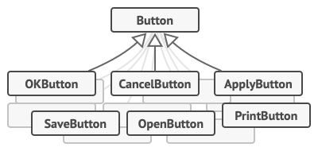
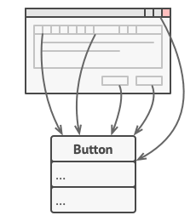
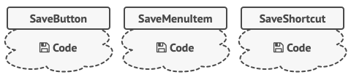
Your App has Many Buttons
Button
Each Button has its own Code
https://www.youtube.com/watch?v=XW-gKMFbOyc
Notes:
Start with a button > Many buttons in an app > Each button has its own code

Slide 6
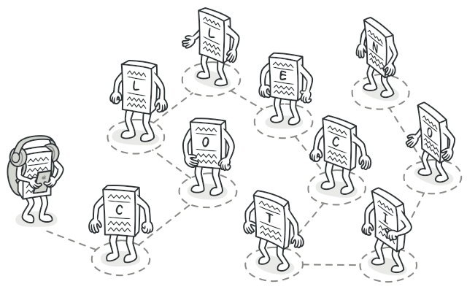
Iterator
lets you traverse elements of a collection without exposing its underlying representation (list, stack, tree, etc.).

Slide 7

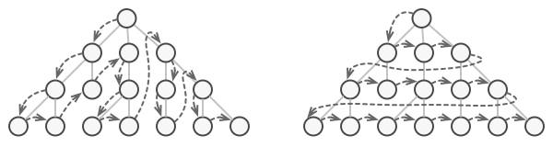
How do you iterate a tree?
https://www.youtube.com/watch?v=Gco6zF_ygSc

Slide 8
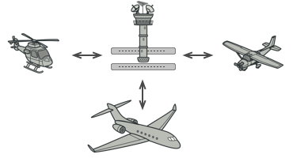
Mediator
Reduces chaotic dependencies between objects by having them communicate through a mediator object
https://www.youtube.com/watch?v=FDtPLhOpdQ8

Slide 9

Memento
Similar to the Command pattern, this one looks to create period Save States allowing the user to undo actions.

Slide 10
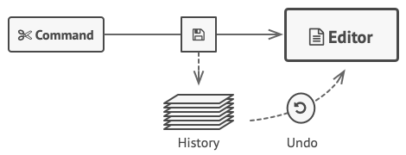
The basic idea for a text editor
The Problem: How would you create these snapshots?

Slide 11
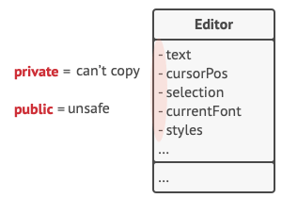
The Problem: How would you create these snapshots?
From the outside you run into these problems:

Slide 12
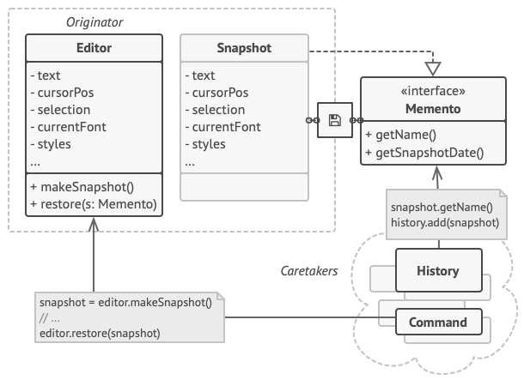
The Solution:
Have the originator create the snapshot - Caretakers
https://www.youtube.com/watch?v=29VQcHxWu7g

Slide 13
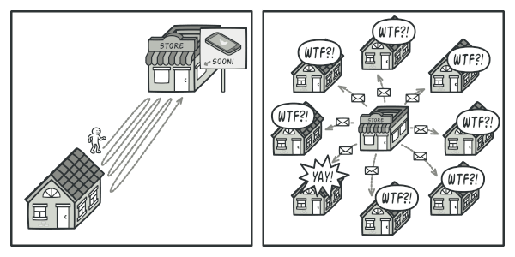
Observer
Problem:
Checking Store Spamming
Every Day Emails

Slide 14
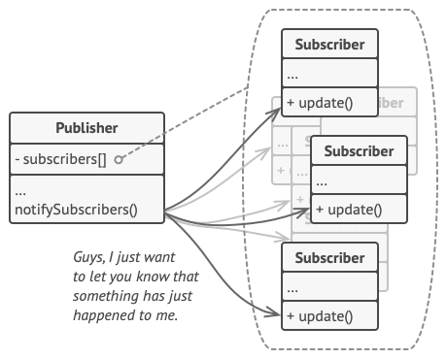
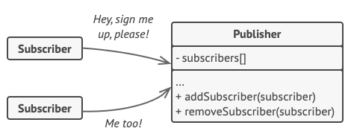
Hit that Subscribe button
https://www.youtube.com/watch?v=8nICu7ZSPtE

Slide 15
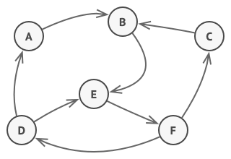
State

Slide 16
FSM States
Nir to explain the 5 states of a FSM
Arthur to provide a proof of
A Finite State Machine M such that if the number of states n>=2, then there exits i
≡i=≡i+1
Or ith equivalence class = i+1th equivalence class

Slide 17
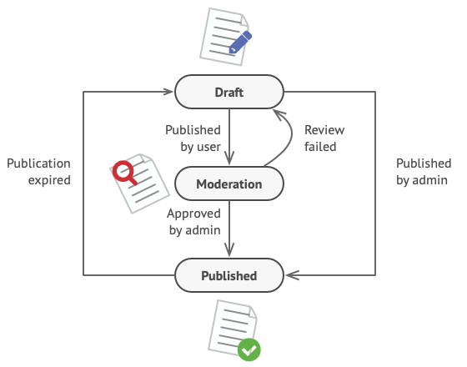
Problem
This can become overly complex if more and more states are added.
https://www.youtube.com/watch?v=abX4xzaAsoc

Slide 18
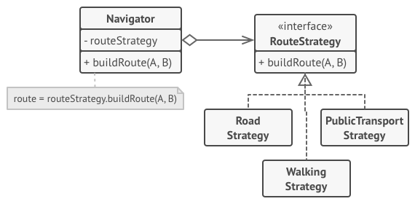
Strategy
Take a class that does something specific in a lot of different ways and extract all of these algorithms into separate classes called strategies.
https://www.youtube.com/watch?v=E9-4uaoncVY

Slide 19
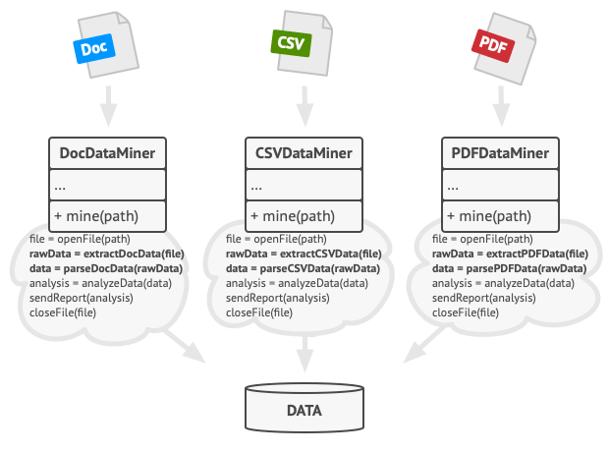
Template Method
Concept:
- Create a skeleton superclass
- Allow Subclasses override specific steps

Slide 20

<<abstract class>>
Yoshi
+ Jump()
+ Move()
+ Eat()
# SpecialAttack()

Slide 21


<<abstract class>>
Yoshi
+ Jump()
+ Move()
+ Eat()
# SpecialAttack()
<<concrete class>>
Red Yoshi
<<concrete class>>
Blue Yoshi
+ SpecialAttack()
+ SpecialAttack()

Slide 22
Visitor
Add new operations to a group of related classes without modifying their structures.

Slide 23


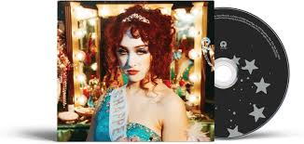



Slide 24
<<Interface>>
IAmazonItem
+ Cost()
+ Name()
+ AddToCart()
https://www.youtube.com/watch?v=pL4mOUDi54o

